Slide 1
An investigation on AI Markets
August 2021

Slide 2
Affected Industries

Slide 3
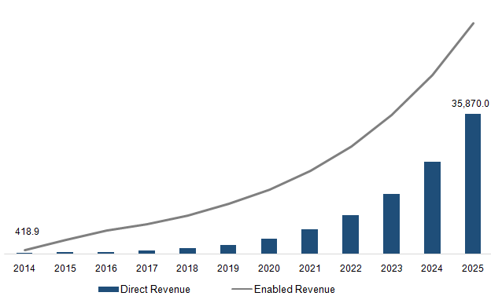
AI market for each industry….
Artificial Intelligence Direct & Enabled Revenue
Artificial Intelligence Market, 2019
Note: There are plenty of categorization, obviously they may not be the same!

Slide 5
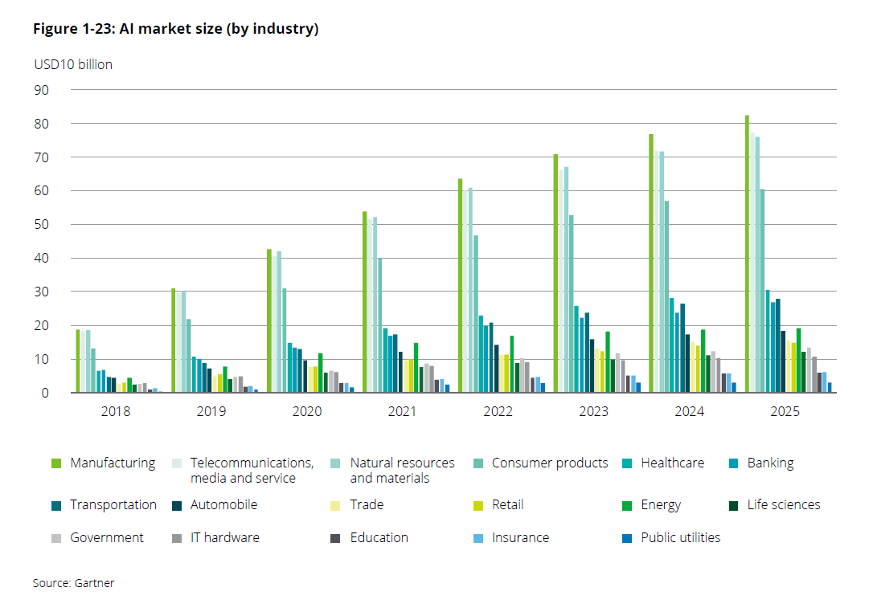

Slide 7
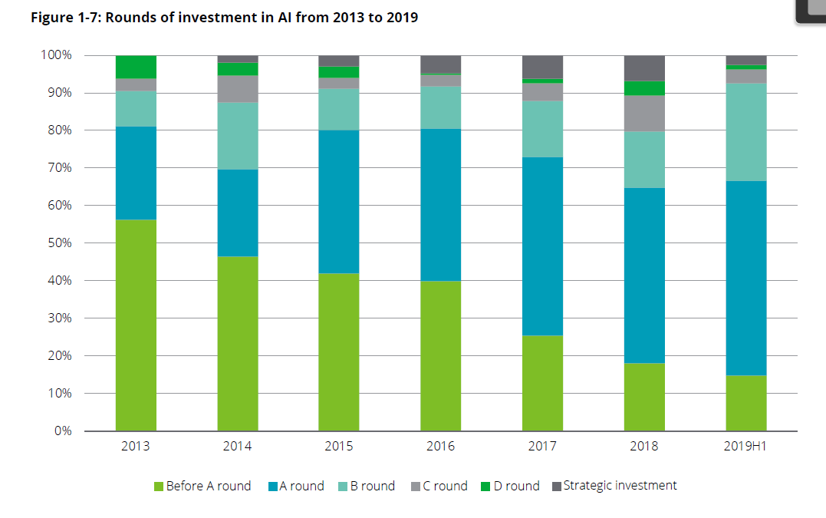

Slide 8
Not In That Detail!
Artificial Intelligence
Health & Medicine
Marketing
Financial & Banking
Education
Logistic & Transportation
Media & Entertainment
Energy

Slide 9
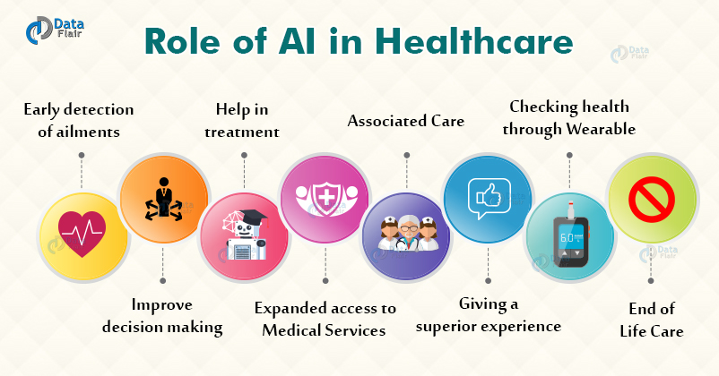
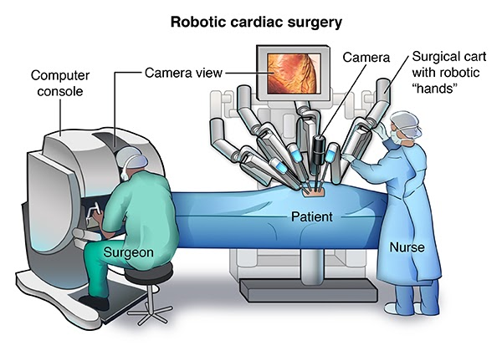
A bit deeper (Health)
Health & Medicine
Early Detection
Help in Treatment
Associated Care
Superior Experience
Health Checking

Slide 10
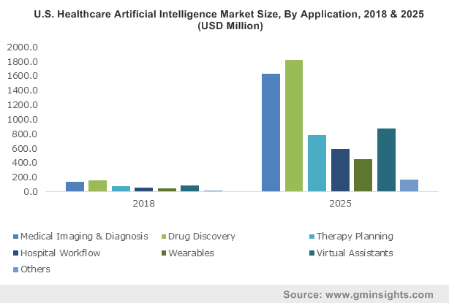
Health & Medicine

Slide 11
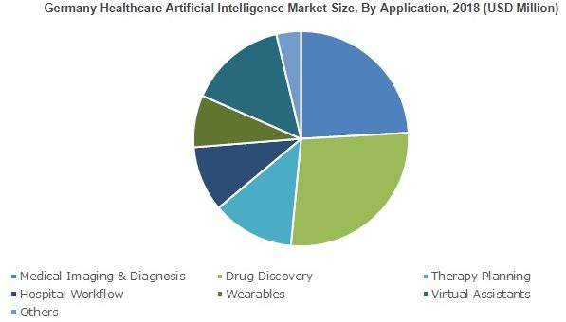
Health & Medicine (Cont.)
Note: These two countries (USA-Ger) are the leading countries in healthcare investments

Slide 12
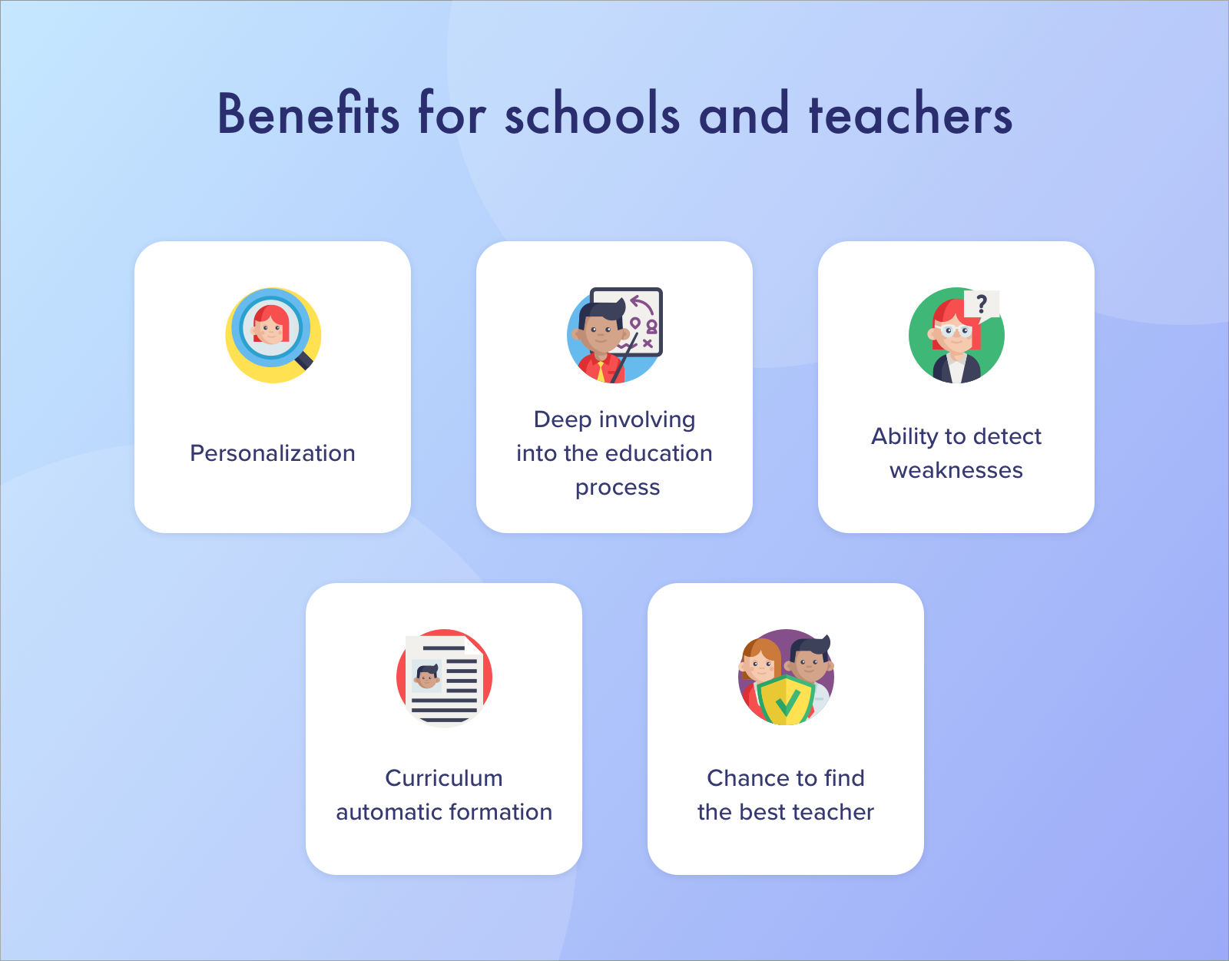
A bit deeper (Education)
Education
Personalization
Automated Education Process
Gamification
Open Educational Resources (ORE)

Slide 13
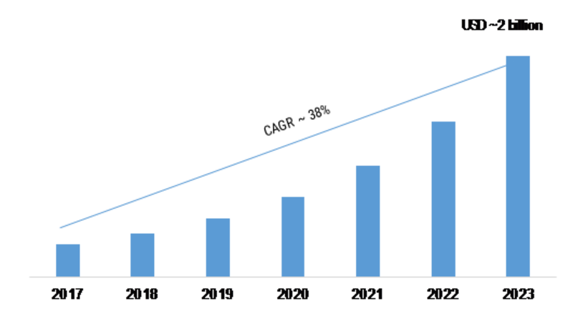
Education

Slide 14
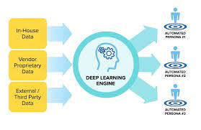
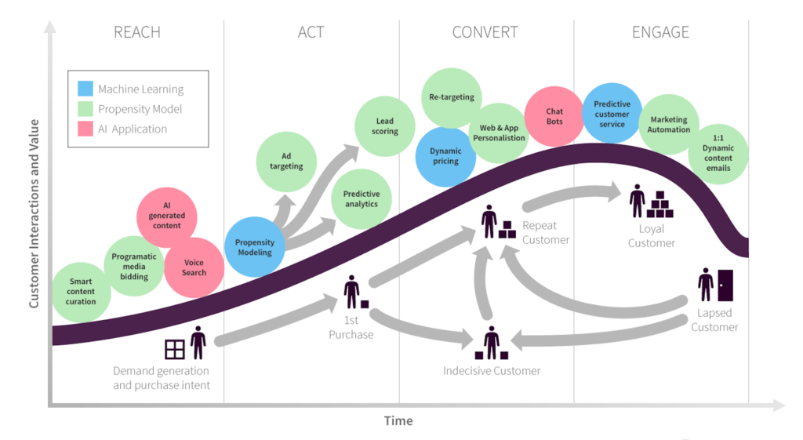
A bit deeper (Marketing)
Marketing
Business Analytics
Chatbots
Marketing Automation
Generated Content

Slide 15
Marketing
Note: Automation in Customer Services takes the most beneficial market

Slide 16
Marketing(Cont.)

Slide 17
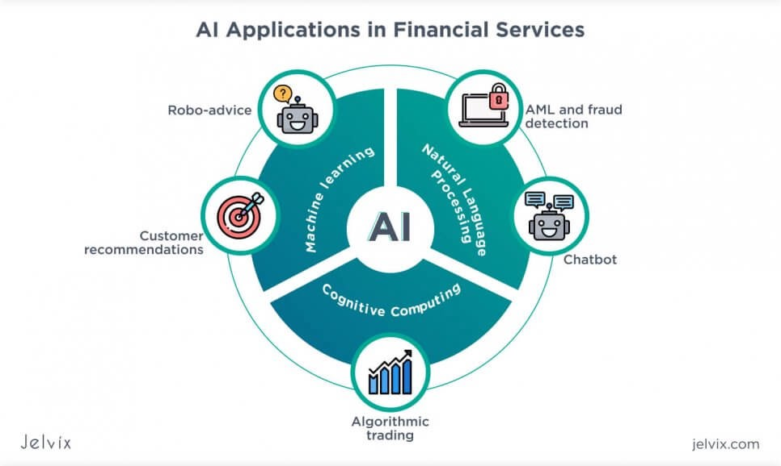
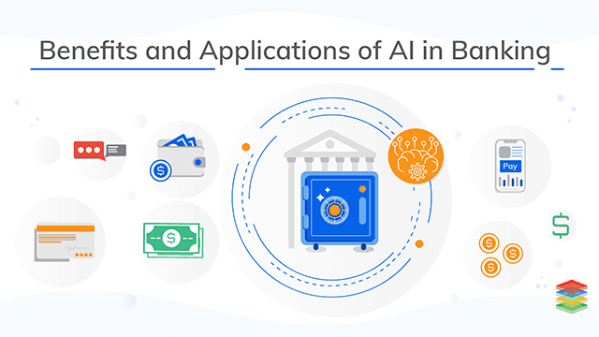
A bit deeper(BFSI)
Financial & Banking
Algorithmic Trading
Robo-advice
Customer Recommendations
AML & Fraud Detection

Slide 18
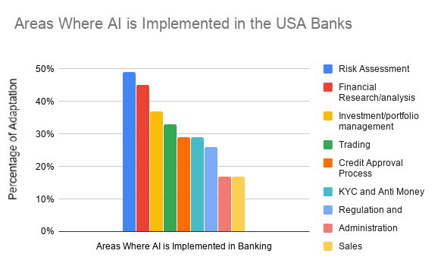
Financial & Banking

Slide 19
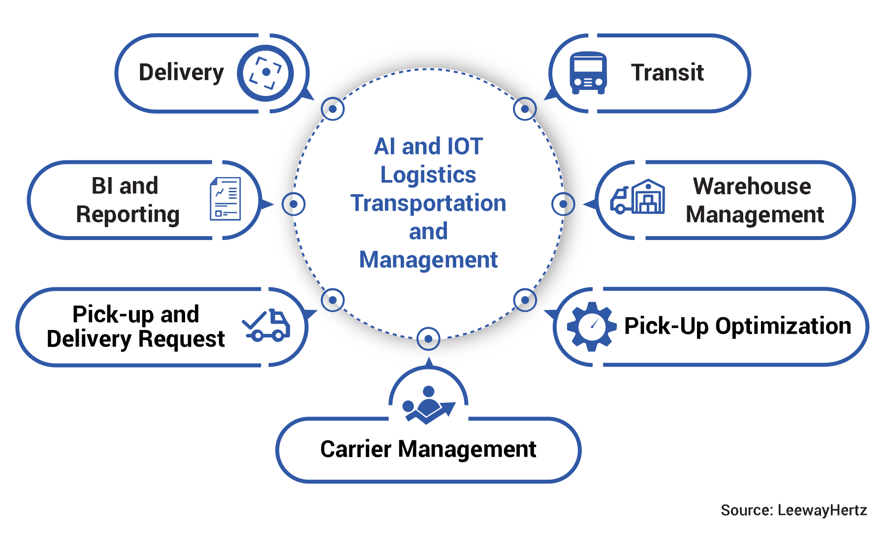
A bit deeper(Logistic & Transportation)
Logistic & Transportation
Planning
Smart Routing
Automated Warehouse
Autonomous Vehicles

Slide 20
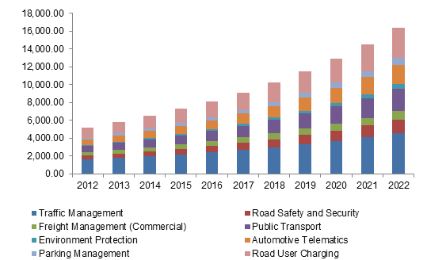
Logistic & Transportation
Asia, Intelligent Transportation system, by application

Slide 21
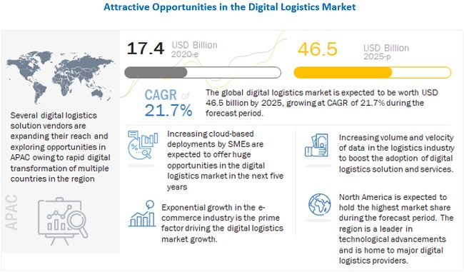
Logistic & Transportation (Cont.)

Slide 22
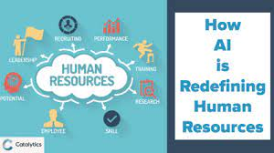
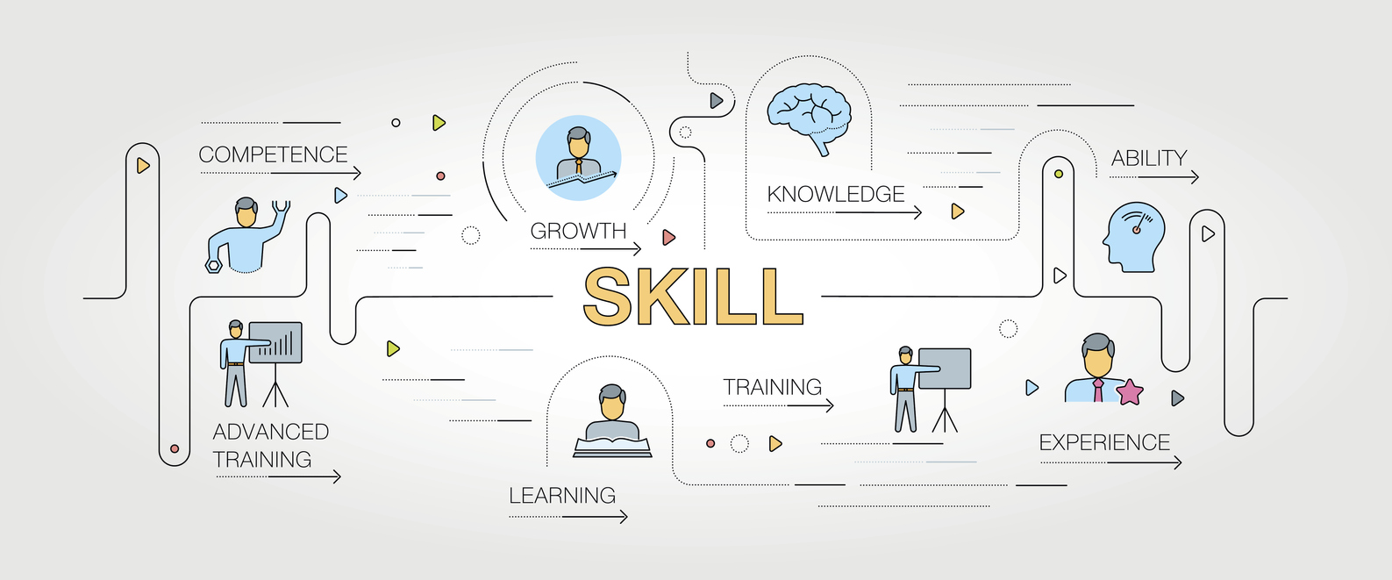
A bit deeper (Media & Entertainment)
Media & Entertainment
Targeted Content
Discovery & Recommendation
Reporting Automation
Boosting User Experience

Slide 23
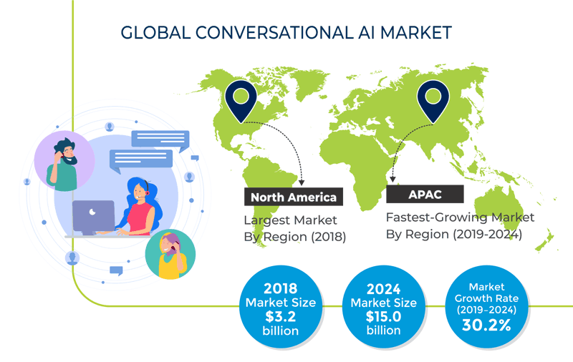
Media & Entertainment

Slide 24
Media & Entertainment (Cont.)

Slide 25
A bit deeper (Human Resource)
Human Resources
Hiring & Recruitment
Automation & Profiling
Retention
On-boarding & Training

Slide 26
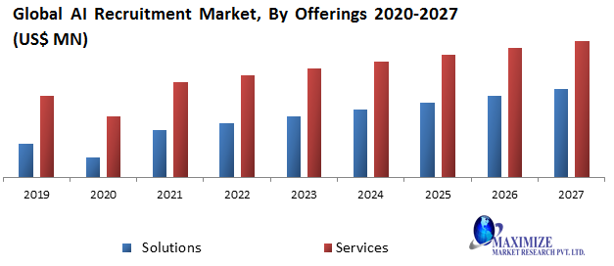
Human Resources

Slide 27
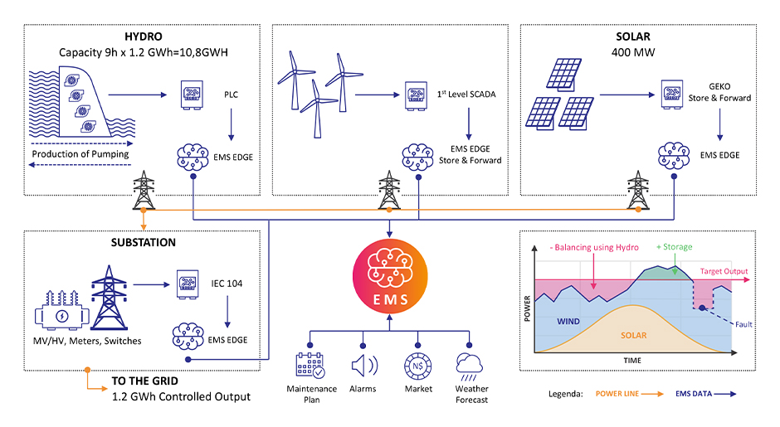
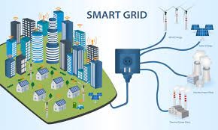
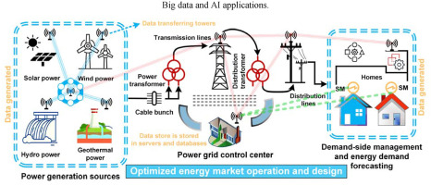
A bit deeper (Energy)
Energy
Efficiency Enhancing
Smart Grid
Renewable Energy Sectors
Algorithmic Trading

Slide 28
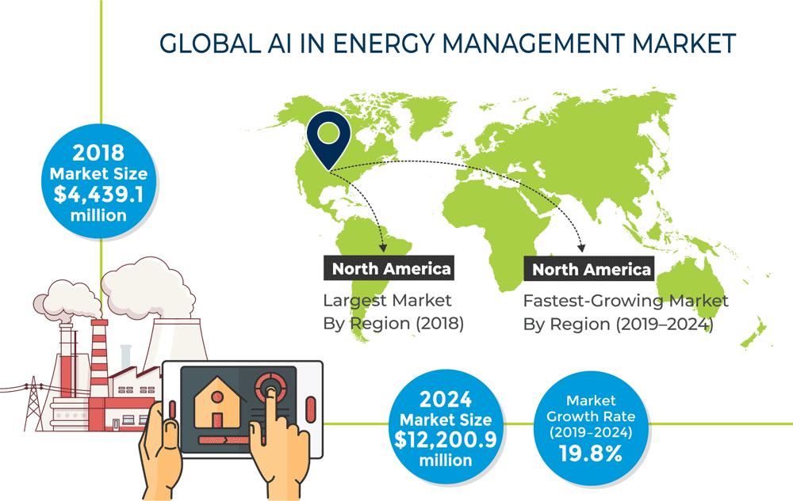
Energy

Slide 29
Energy (Cont.)

Slide 30
There is NO place like home!
Let’s redo our previous investigations for Iran ;)

Slide 31
Ranking in AI Researches
Iran ranks first in AI research in West Asia, 2019

Slide 32
Companies in detail
There are plenty of companies in Iran, that has been entered to this new emerged technology.
These companies contributes in all major parts of Artificial Intelligence
In this investigation, major involved companies are being studied, and their scope of activity will be consider

Slide 33
Arman Rayan Sharif
Nojan Robotics and Artificial Intelligence
Asr Gooyesh Pardaz
Fanap
Part AI Research Center

Slide 34
Arman Rayan Sharif
Company Name | Arman Rayan Sharif
Industry | Information Technology & Services
Company Size | 11-50 employees
Headquarters | Tehran, Tehran
Founded | 2014
Specialties | Artificial Intelligence, Machine Learning, Text Processing, Image Processing, Buisiness Intelligence and Social Network Analysis
Main Products | Natural Language Processing Tool, News Analysis, Learning Management System
Website | https://armansoft.ir/

Slide 35
Nojan Robotics and Artificial Intelligence
Company Name | Nojan Robotics and Artificial Intelligence
Industry | Industrial Automation
Company Size | 11-50 employees
Headquarters | Tehran, Tehran
Founded | 2014
Specialties | robotics, machine learning, deep learning, automation, electronic board design, controller desing
Main Products | Light Post Painter Robot, Light Post Washer Robot
Website | http://www.nojanco.ir

Slide 36
Asr Gooyesh Pardaz
Company Name | Asr Gooyesh Pardaz
Industry | Computer Software
Company Size | 11-50 employees
Headquarters | Tehran, Tehran
Founded | 2006
Specialties | Speech Processing, IVR, ASR, Image Processing, AI, Data Mining, Voice Recognition, Persian speech dictation, Interactive Voice Response, keyword spotting, steganography, OCR, Speaker recognition, identification, and verification
Main Products | Nevisa(Persian Typing Assistant Tool), Kara(Persian Voice Assistant), Parsia, Ariana, jooya(Persian Search in voice Tool)
Website | http://www.asr-gooyesh.com

Slide 37
Fanap
Company Name | Fanap
Industry | Information Technology & Services
Company Size | 1001-5000 employees
Headquarters | Tehran, Tehran
Founded | 2005
Specialties | Modern General Solution Services for Financial Industry, Developing Investment Services in IT, and General Contractor Services for IT Based Projects
Website | http://fanap.ir/

Slide 38
Part AI Research Center
Company Name | Part AI Research Center
Industry | Information Technology & Services
Company Size | 201-500 employees
Headquarters | Tehran, Tehran
Founded | 2016
Specialties | Artificial Intelligence, Machine Vision, Data Mining, Speech Processing, NLP, Algorithmic Trading, and Computer Vision identification, and verification
Website | https://partdp.ai

Slide 39
Many Thanks for your consideration

